Slide 1
Motion Tracking using HTC vive
Yuanqing Hong
Mentor: Xin Jin

Slide 2
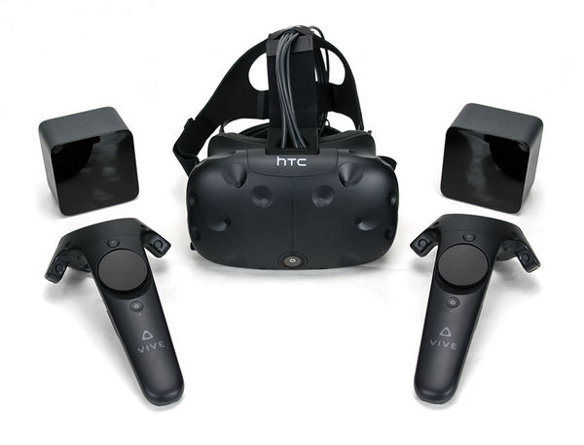
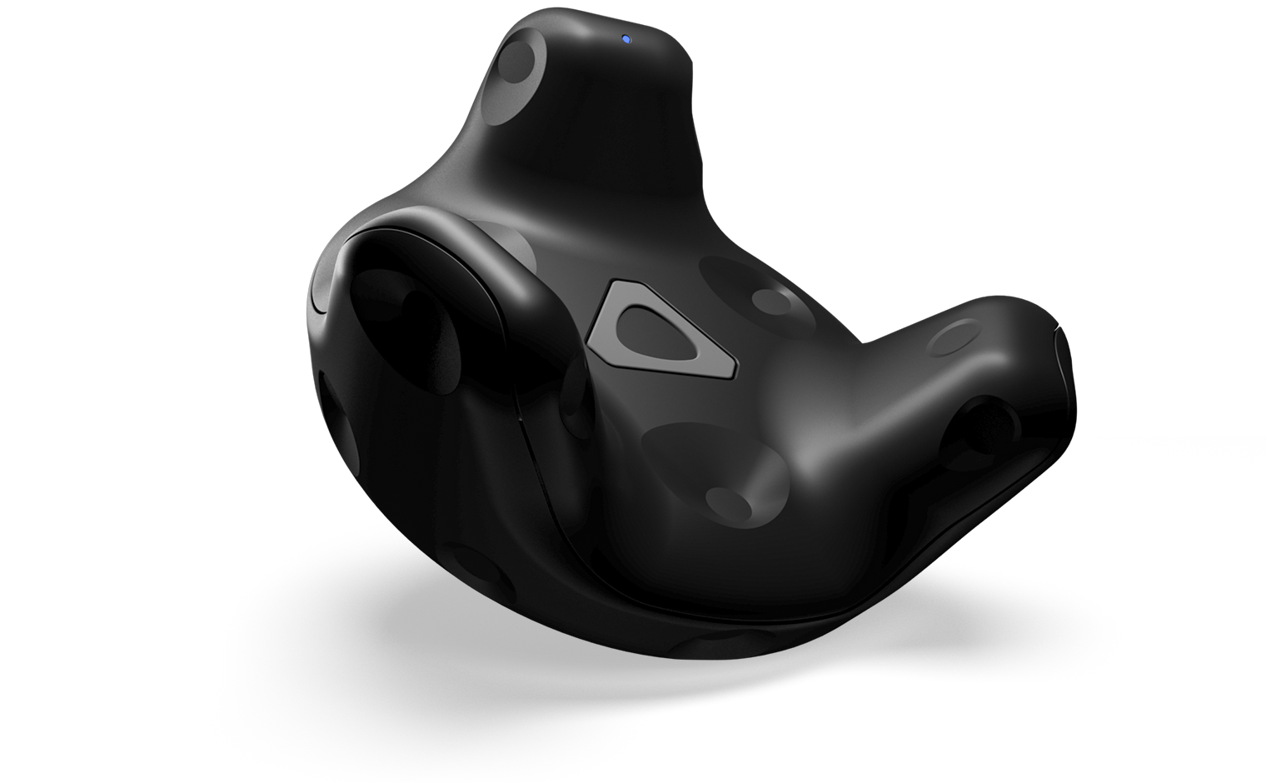
HTC vive
Headset
Base Station
Base Station
Controller
Controller
Tracker

Slide 3
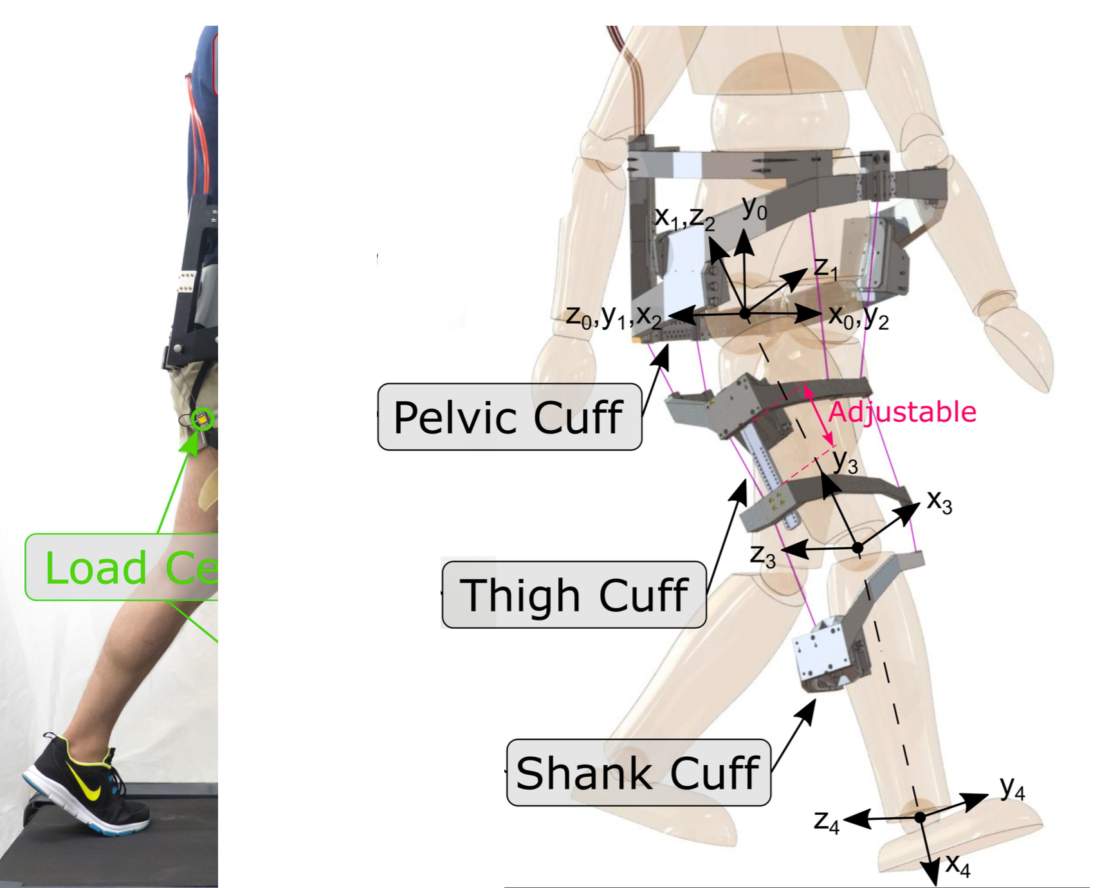
Project Overview
C-Alex
Motion
Capture
Vicon
Workstation
Joint Angles
HTC vive
Actual
Cable Tension
High Level
Control Loop
Motor
Desired
Cable Tension
Low Level
Control Loop

Slide 4
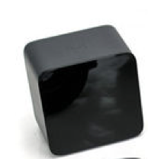
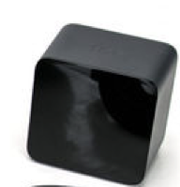
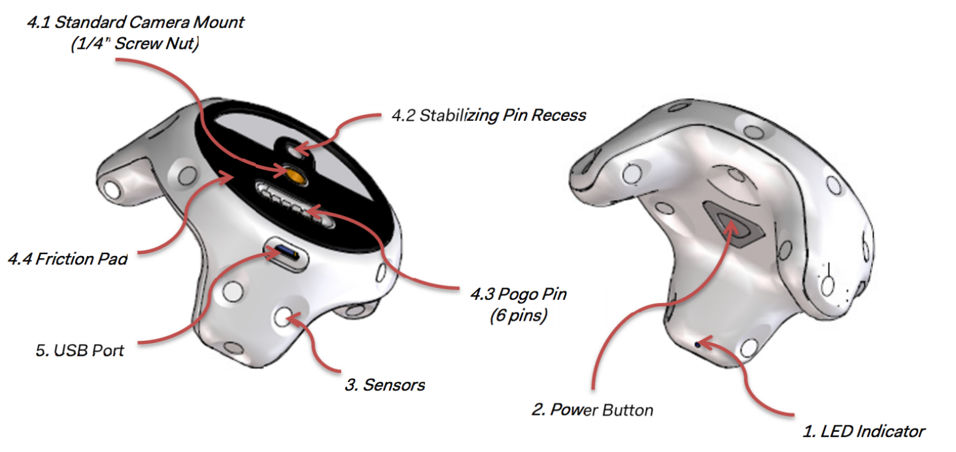
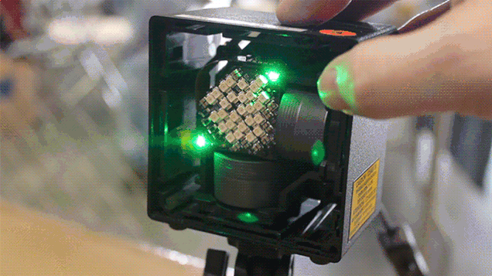
Advantage
Base Stations VS. Cameras
Trackers VS. Markers
2 Lasers provide
Absolute heading
Frequency 120 Hz
Gyroscope
Accelerometer
Frequency 250Hz
Advantage:
Small
2 vs 8
3 vs 10+
Low Cost =$1000
Convenient
Robust
Open-Sources

Slide 5



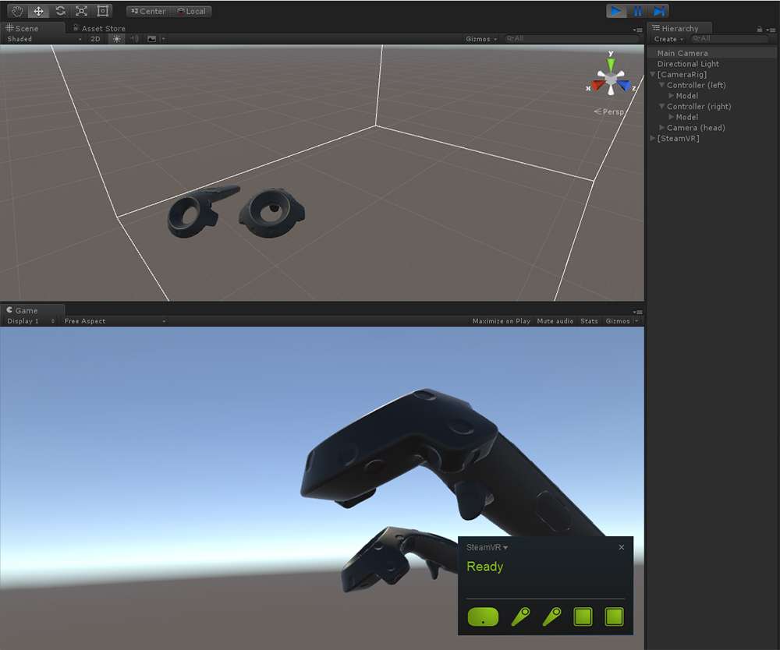
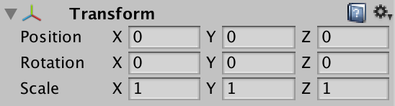
Data and API
Steam VR platform
Unity

Slide 6
Future Work
Experiment1:
Tracking accuracy
Experiment2:
Integrate C-Alex & Tracker
Compare with Vicon
Experiment3:
Using tracker’s 3D position to calibrate cuff location

Slide 7
Time Line and Goals
Jun
Jul
Aug
2017
05/31
6/14
2018
Data Acquisition
17 days
Today
68%
Tacking Accuracy
6/15
6/28
24 days
35%
34 days
Integrate C-Alex & Tracker
6/29
7/12
30%
23 days
25%
35 days
Comparison with Vicon
7/13
7/26
22%
31 days
17%
7/27
8/31
Calibrate Cuff Location

